Slide 2
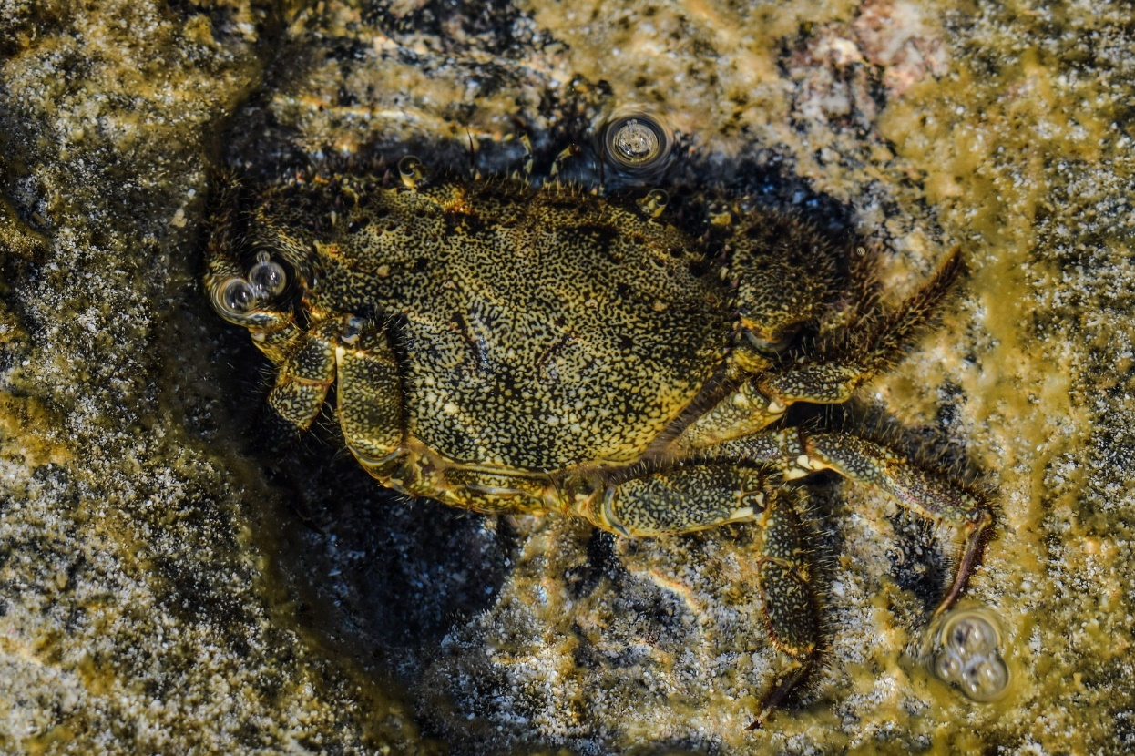
What Is Camouflage?
Camouflage is when an animal has a certain color or pattern on their fur
or skin that helps them to blend into their environment.

Slide 3
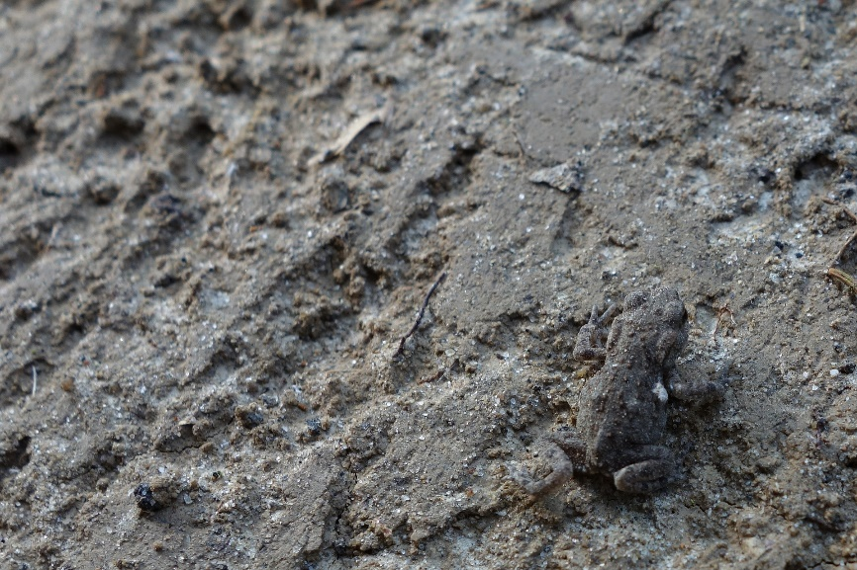
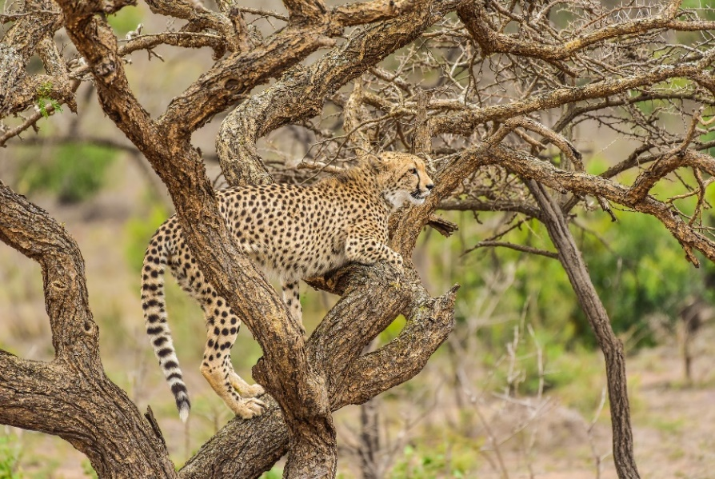
Why Camouflage?
Some animals camouflage so that
they can hide from predators.
Other animals camouflage so that
they can sneak up on their prey
without being seen.

Slide 4
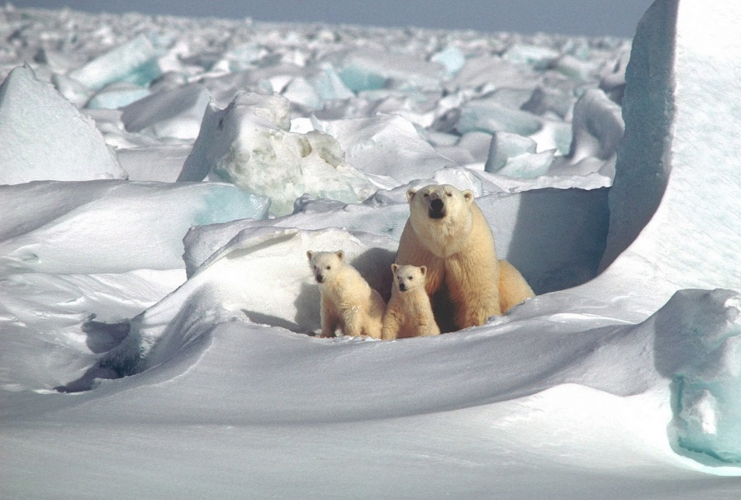
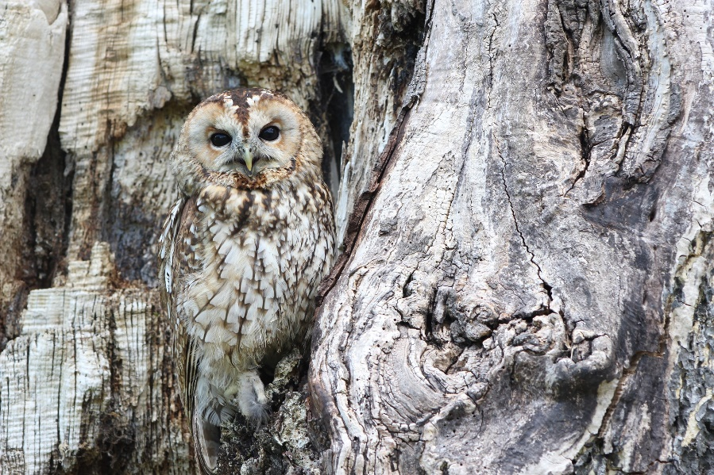
Concealing Coloration
Concealing coloration means that the animal is the same color as its
surroundings so that it can hide within its environment. For example, a
polar bear is white so it can hide in the snow.

Slide 5
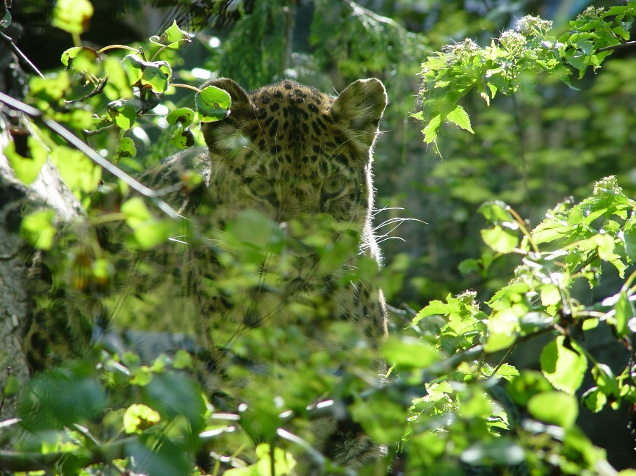
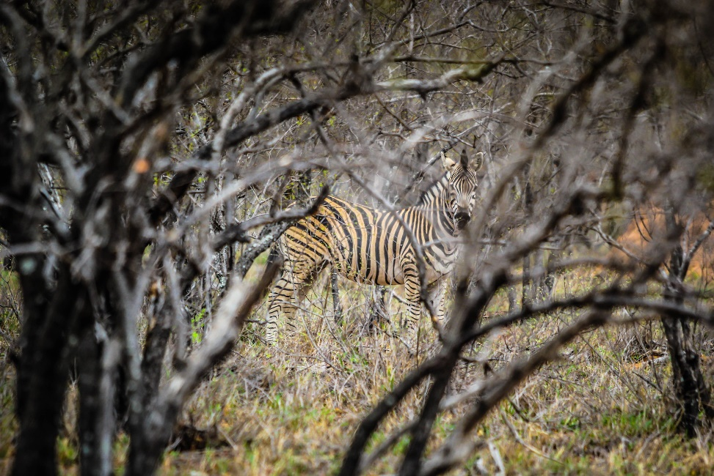
Disruptive Coloration
Animals can also have patterns on their skin or fur to help be concealed
in the environment. This is called disruptive coloration. It disrupts or
breaks up their outline, so they don’t stand out. They may have spots,
stripes, or patterns.

Slide 6
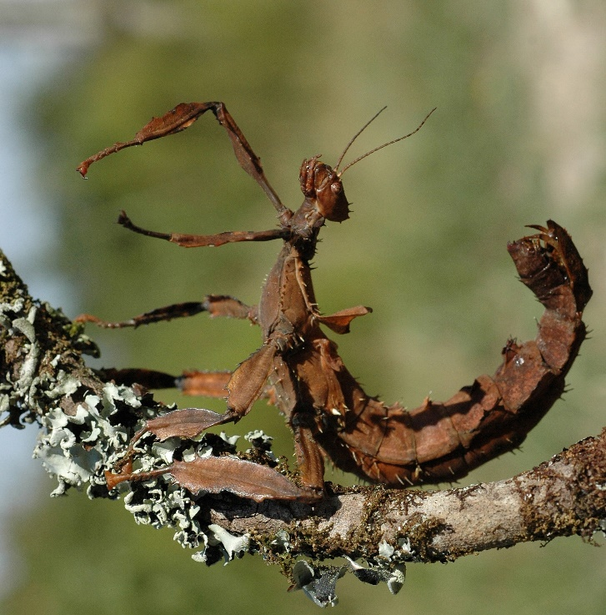
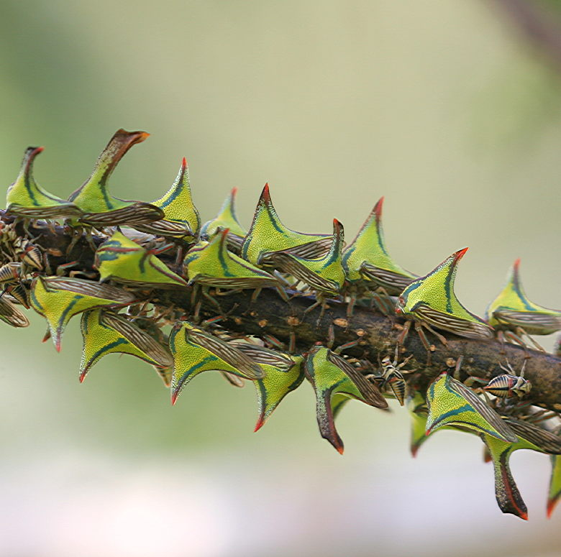
Disguise
Some animals camouflage into their surroundings
by making themselves look like other objects.
Can you think of any?
The spiny leaf insect
disguises itself as a stick.
The thorn bug disguises
itself by mimicking thorns
on a tree branch.

Slide 7
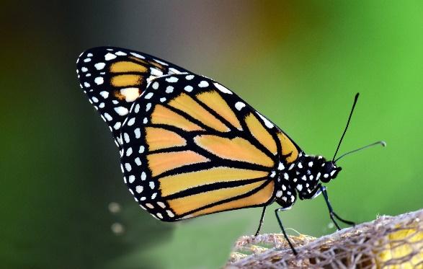
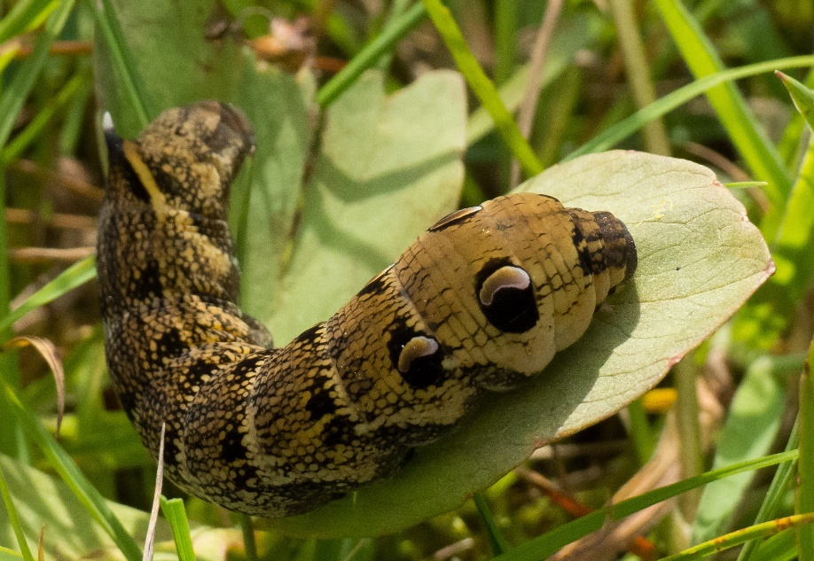
Mimicry
Mimicry is another defense used by animals in which they resemble
another animal that may be dangerous, poisonous, or taste bad.
The viceroy butterfly,
which is nonpoisonous, mimics the monarch butterfly, which is poisonous.
The elephant hawk caterpillar
raises its head and sways
side-to-side to look like a snake
with two false eyes on its head.

