Slide 1
Broadhembury
C of E Primary School
Do you have a child due to start school in September 2021?
We would like to welcome you to our virtual school tour!

Slide 2
We are a small, happy, inclusive and welcoming school in a beautiful village.

Slide 3
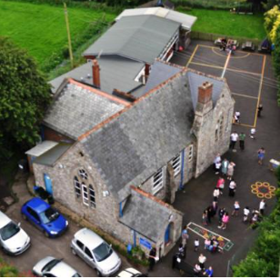

Slide 4
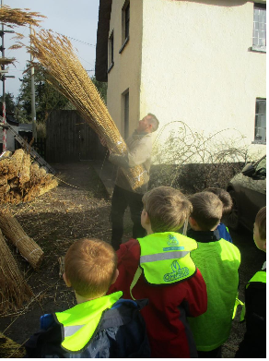
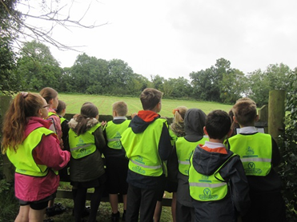

Slide 5
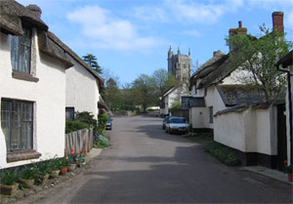
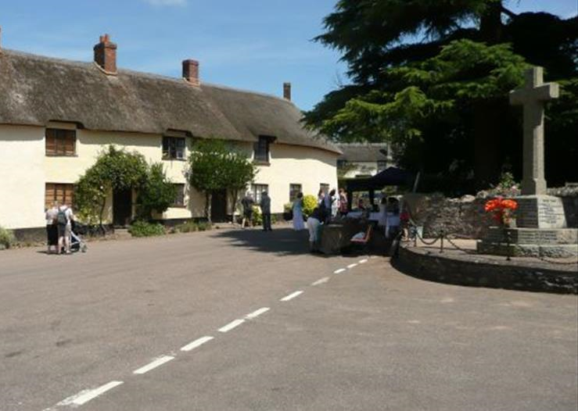

Slide 6
Our Executive Head is
Mrs Katie Gray
Our Head of Learning and SENDCo is Miss Prince
Our Class 1 teacher is Mrs Symonds, who has lots of lovely
Teaching Assistants on hand to help..

Slide 7
Children starting in Early Years will have older pupils in the classroom who will help them to settle into school.

Slide 8
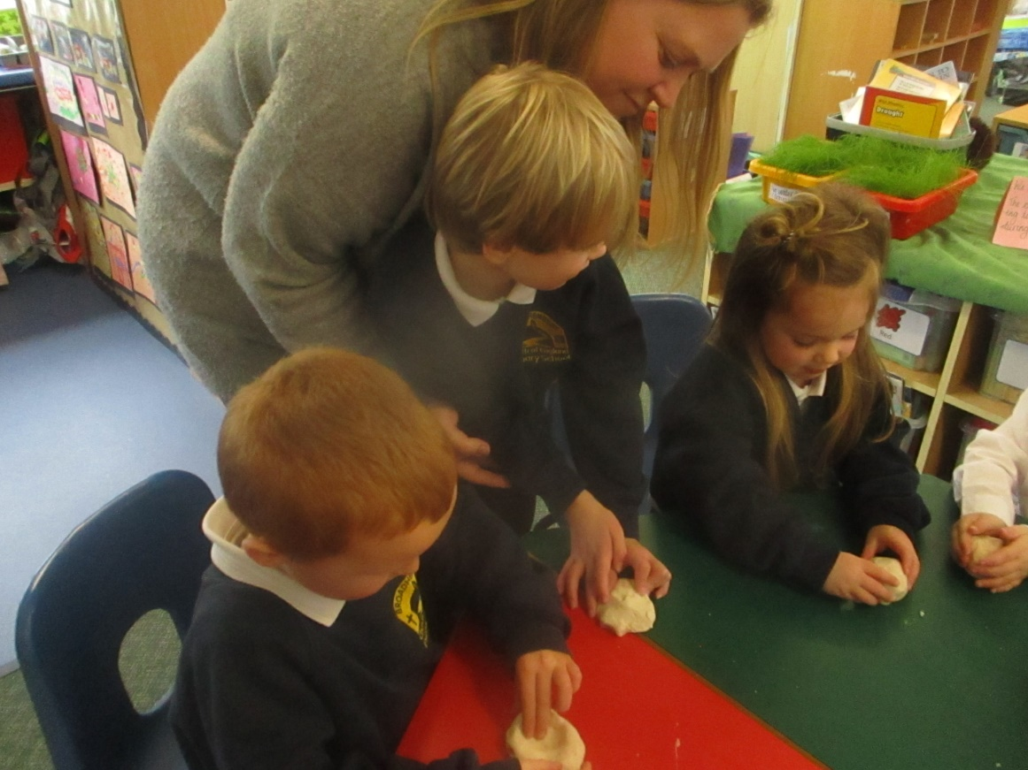
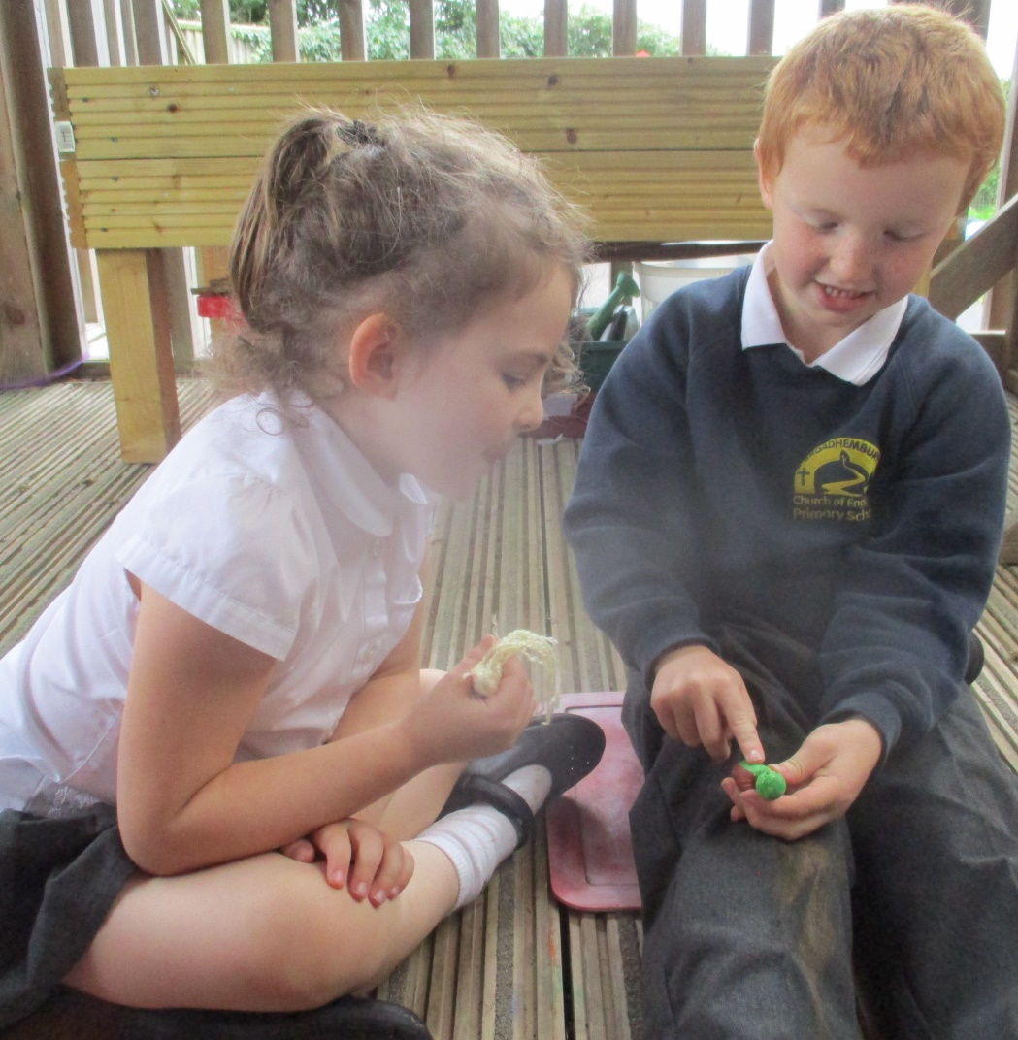
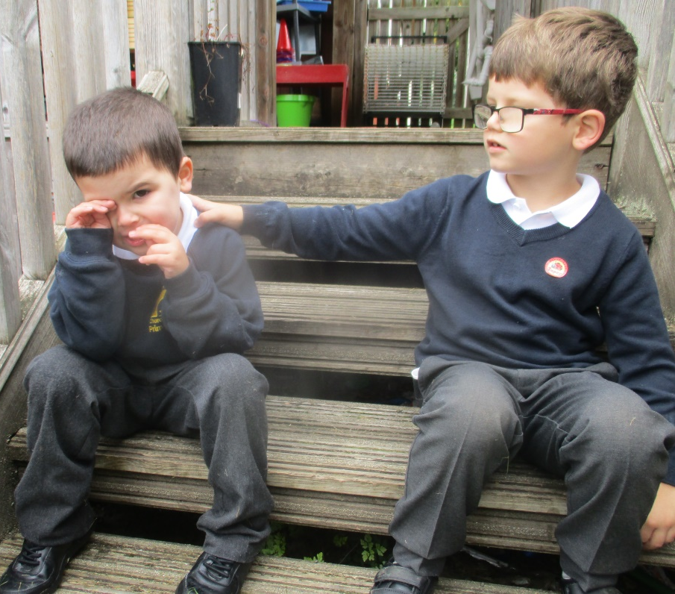

Slide 9
The EYFS curriculum is organised into seven areas of learning
CORE
Physical Development
Personal, Social and Emotional Development
Communication and Language
SPECIFIC
Literacy
Mathematics
Understanding the World
Expressive Arts and Design

Slide 10
Effective learning takes place through
Playing
Exploring
Being active
Creating
Thinking

Slide 11
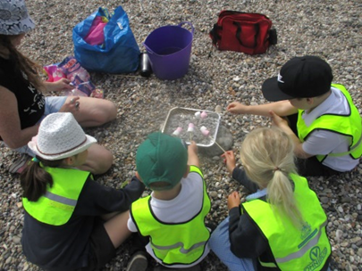

Slide 12
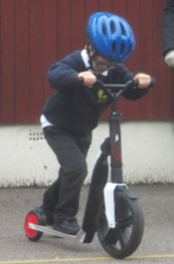

Slide 13
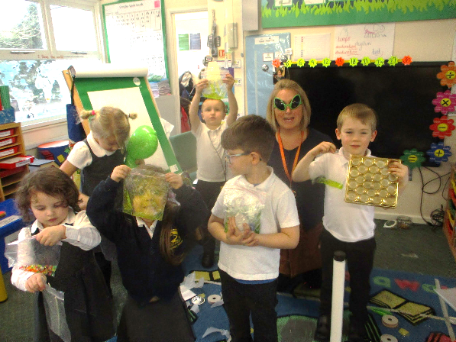
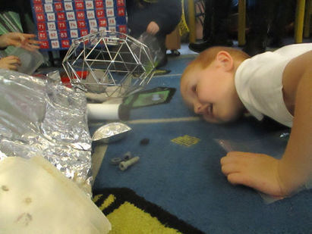

Slide 14
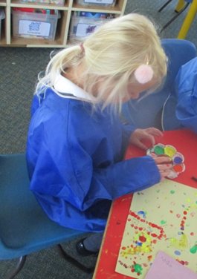
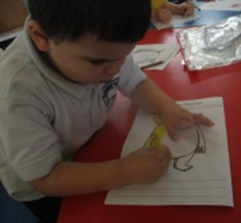
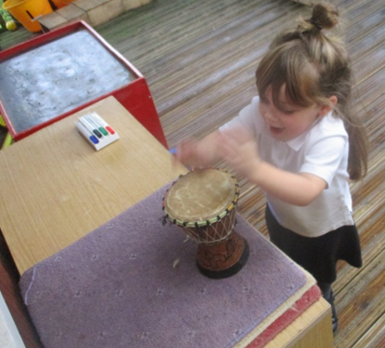

Slide 15
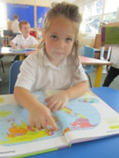

Slide 16
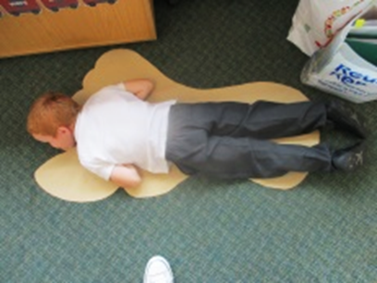
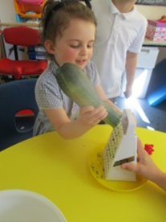

Slide 17
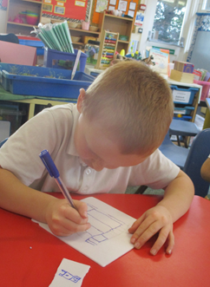
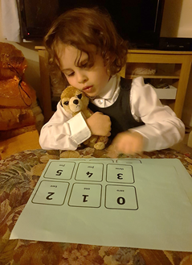
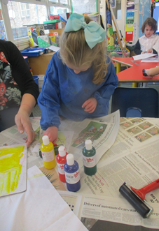

Slide 18
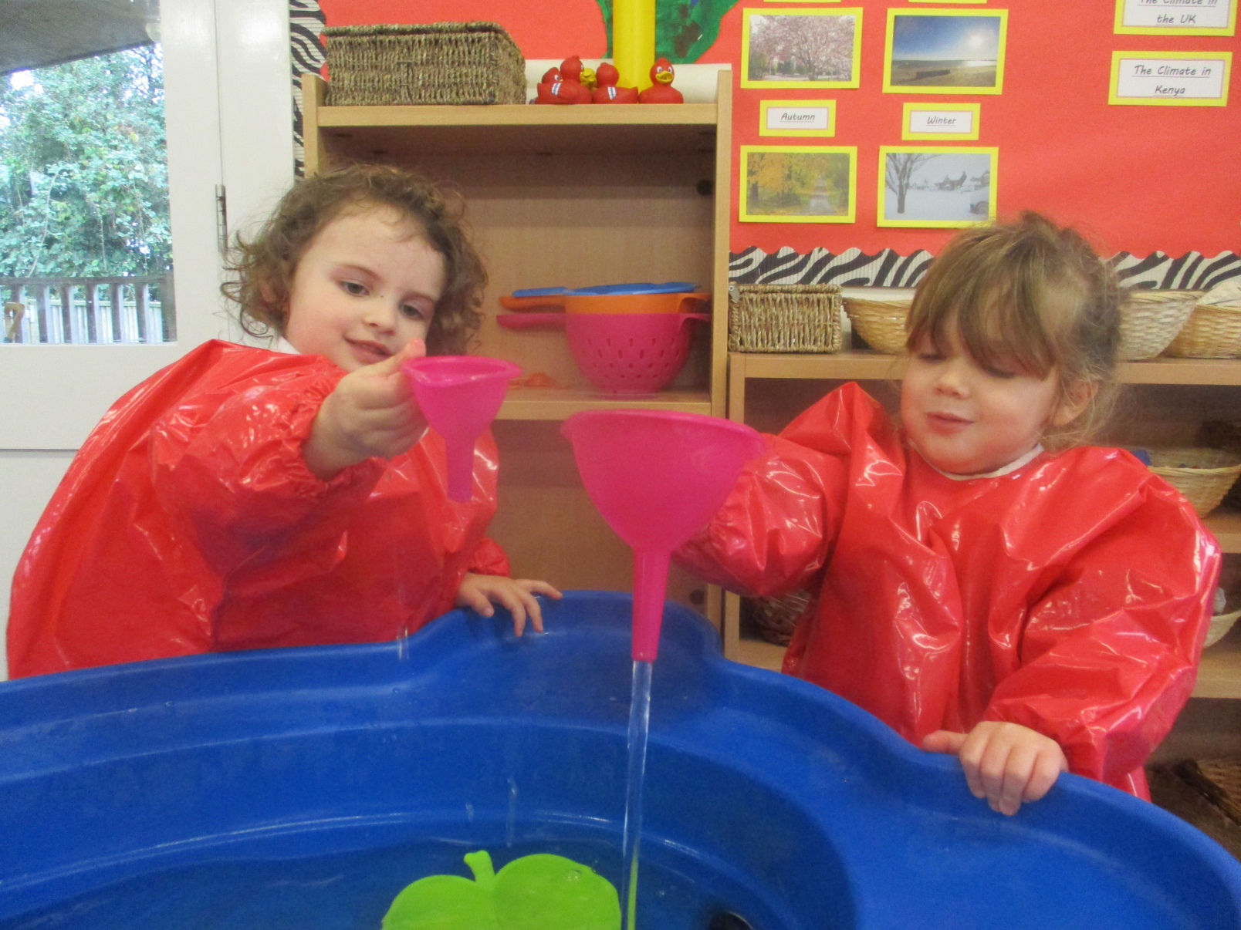
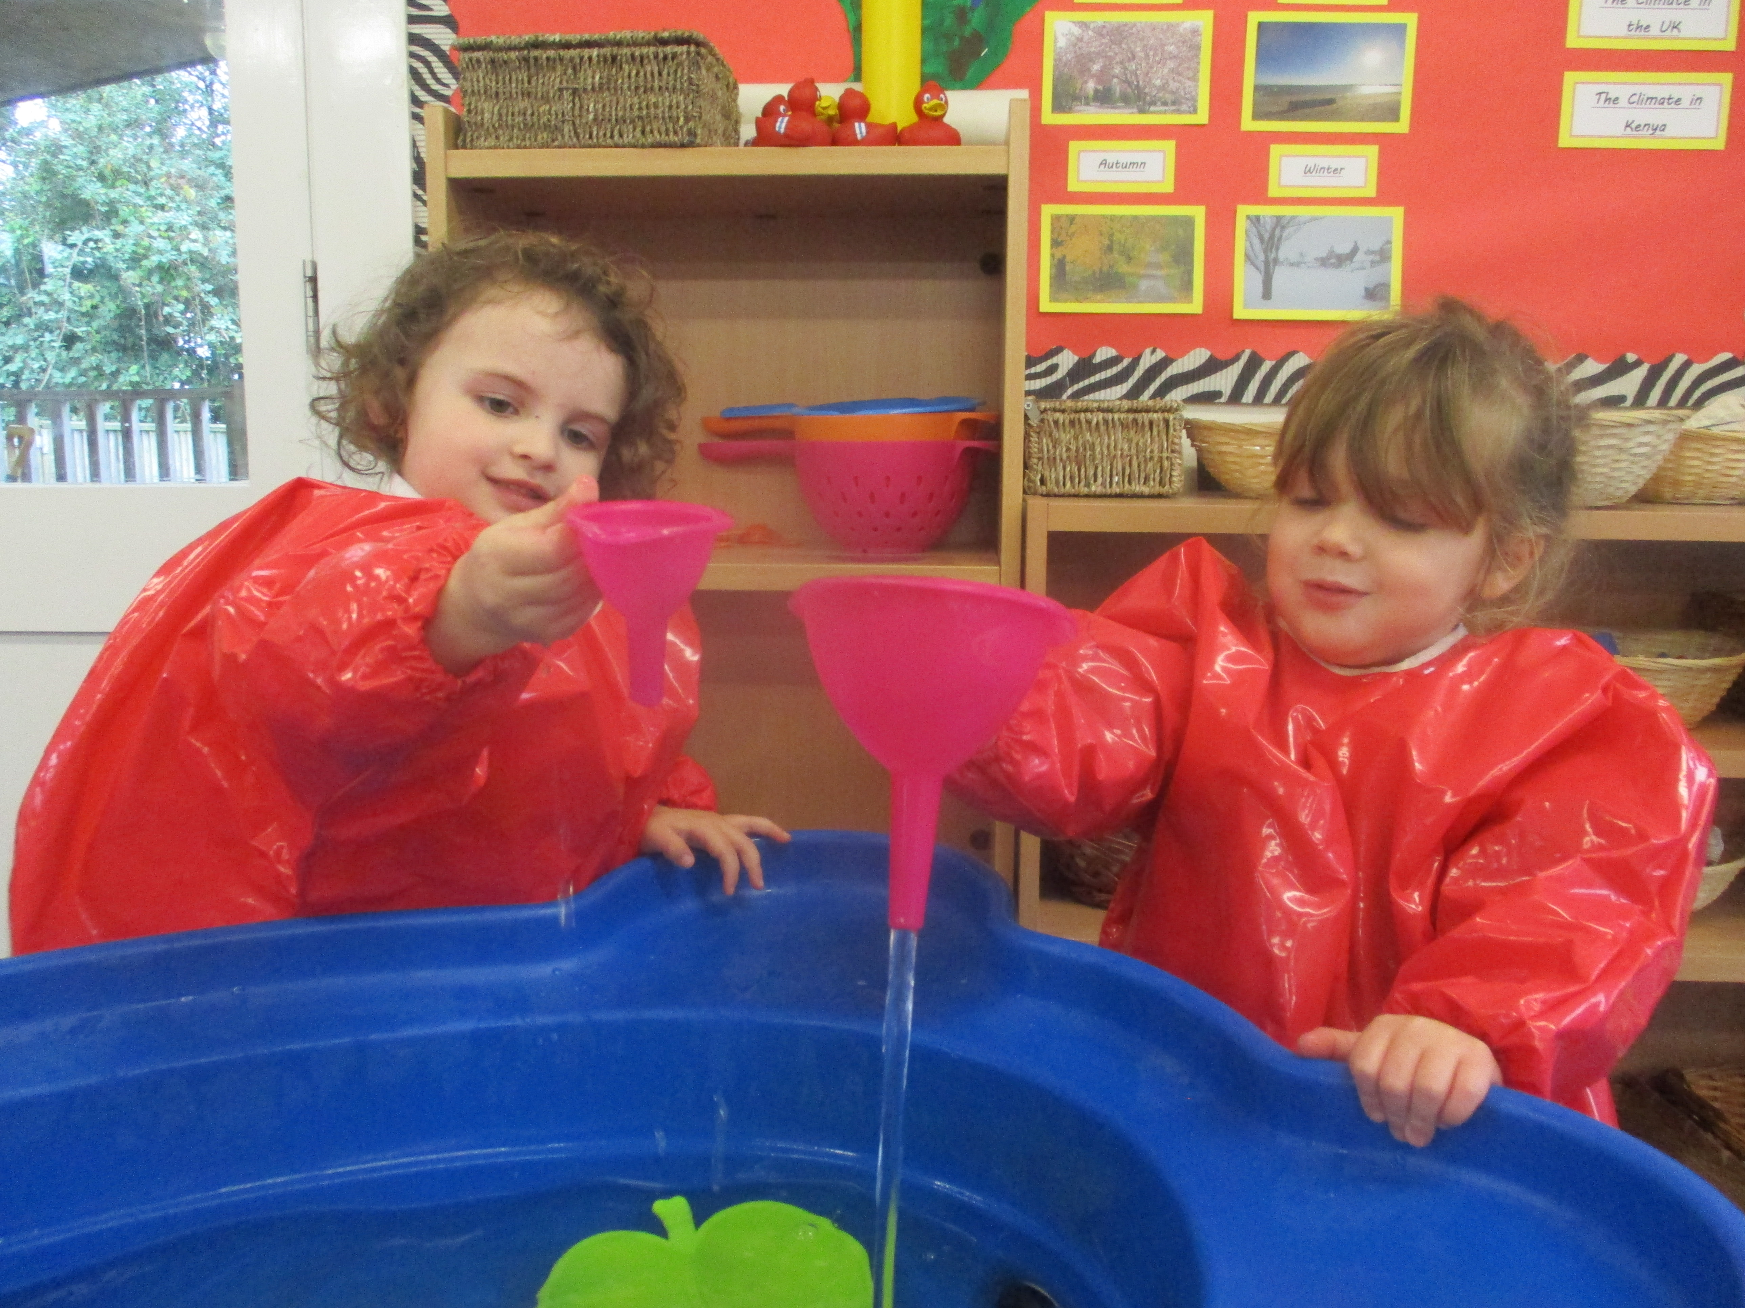

Slide 19
We have super playground facilities.

Slide 20
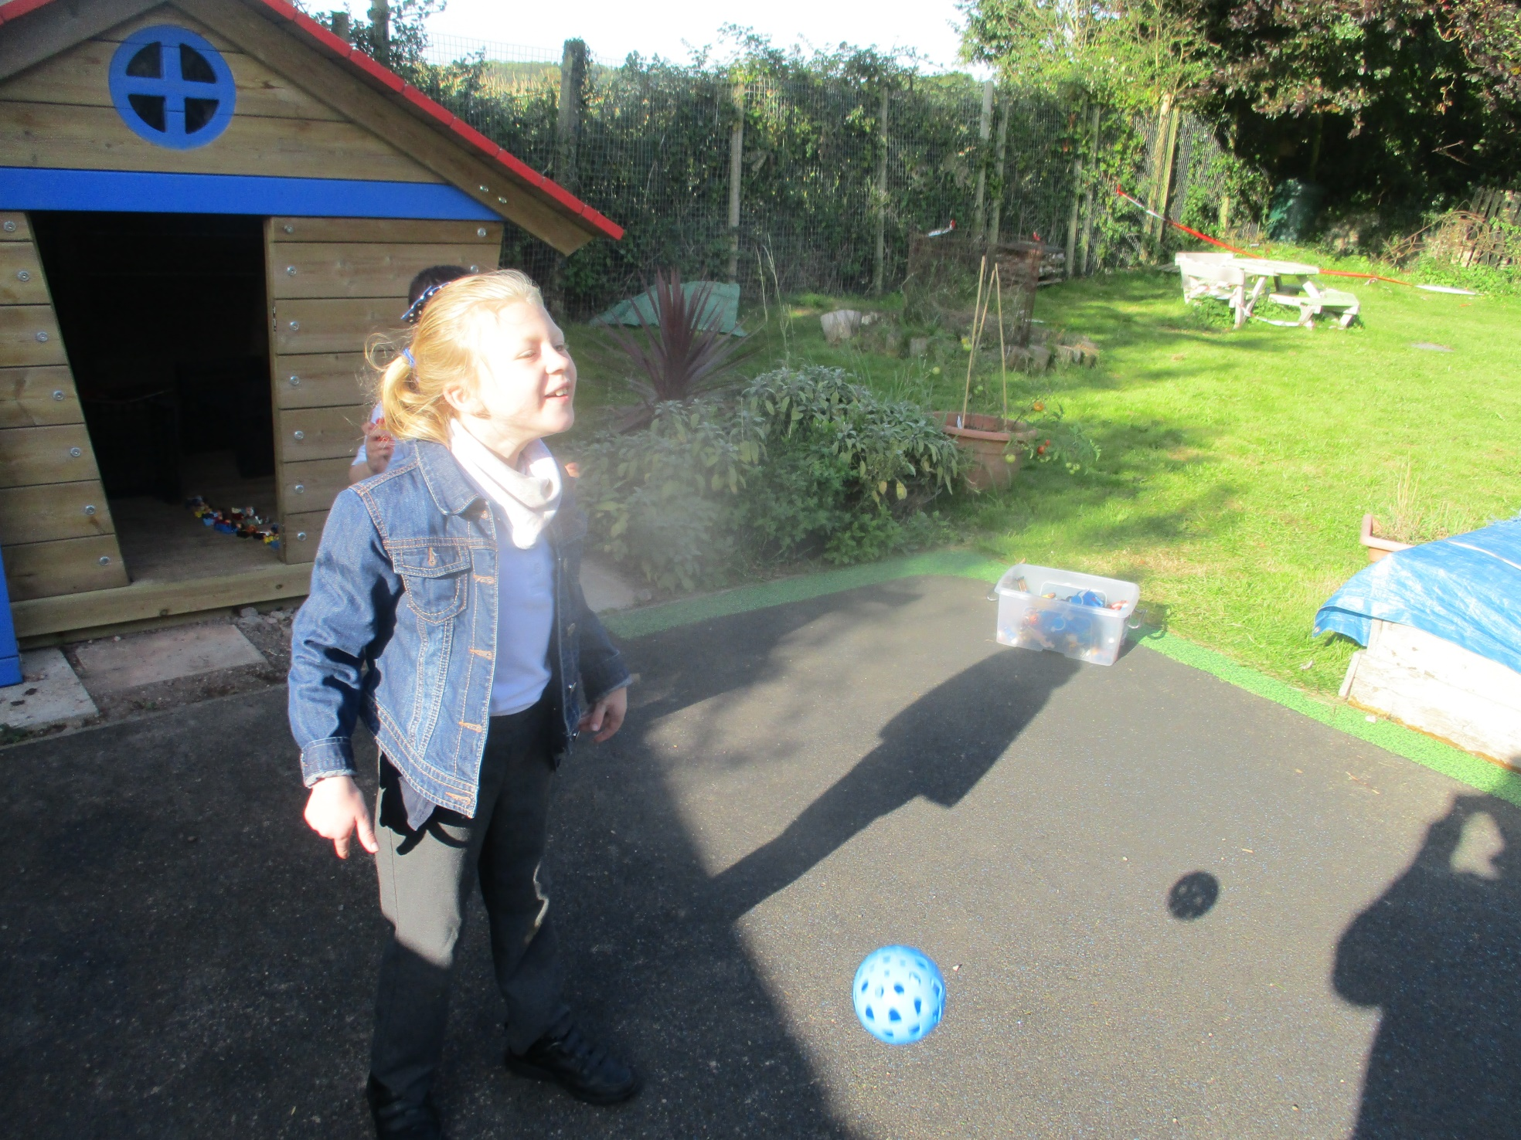

Slide 21
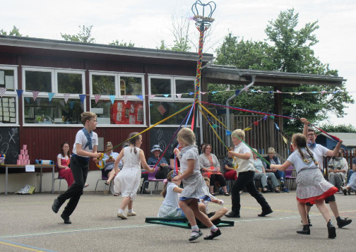

Slide 22
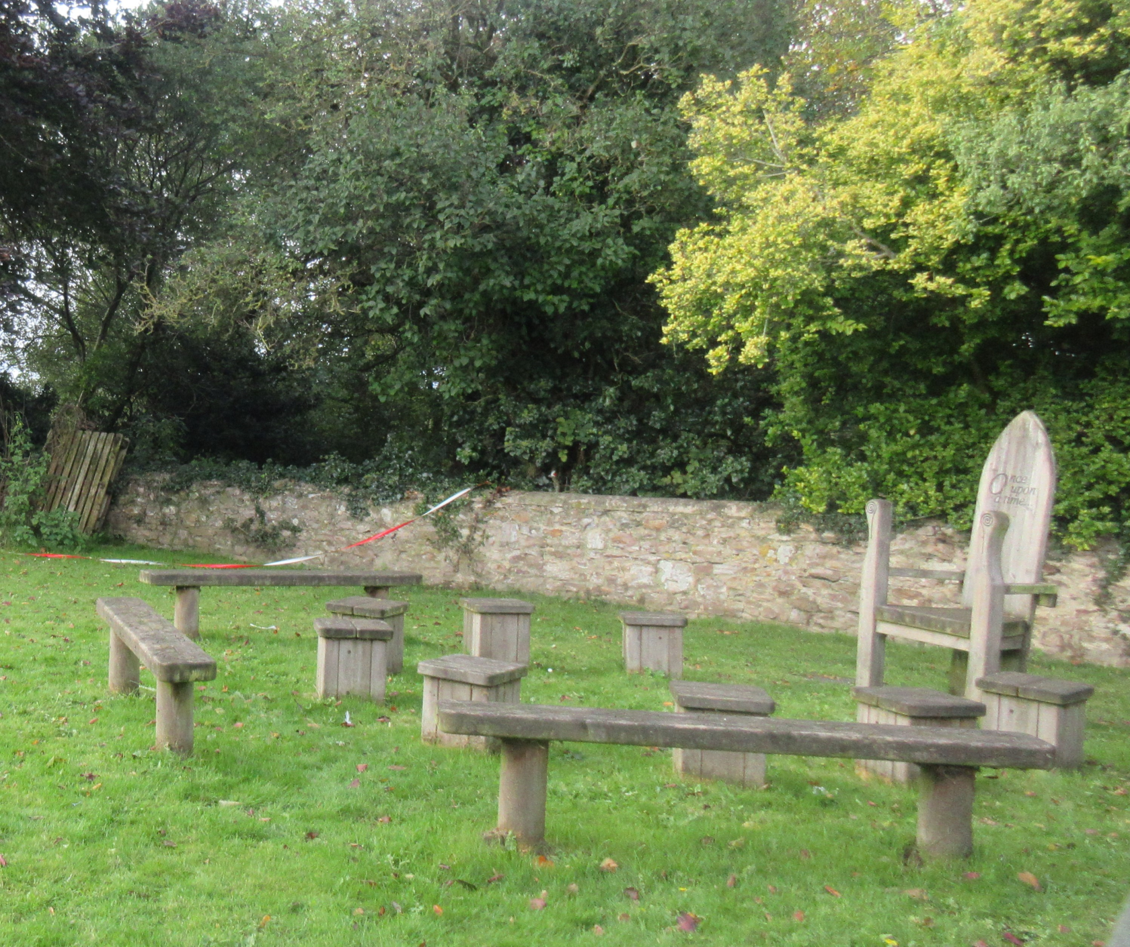

Slide 23
You can enjoy delicious, healthy and nutritious school lunches, and all children are offered breakfast at the start of the day.

Slide 24
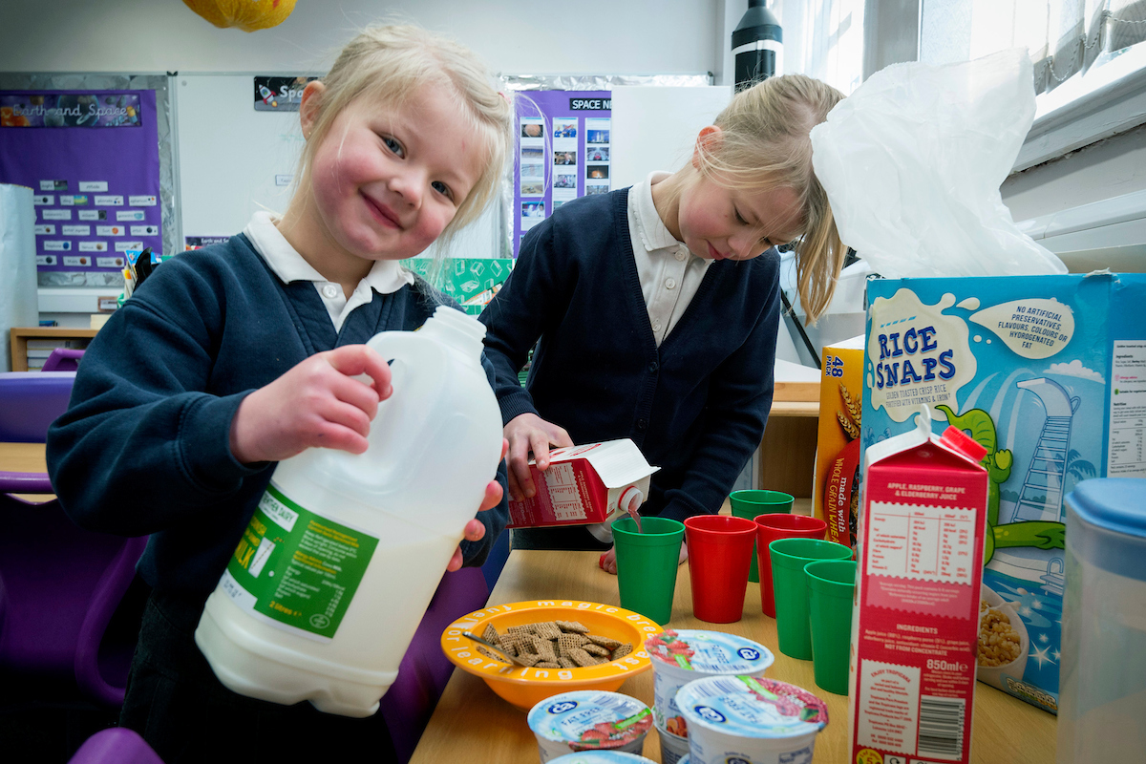

Slide 25
We participate in the Universal Free School Meal Offer.
All children in Reception,
Year One and Year Two can have a free meal provided by school each day.

Slide 26
We love to be adventurous in our outdoor learning space.

Slide 27
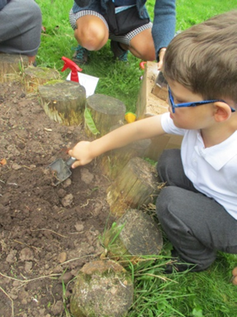
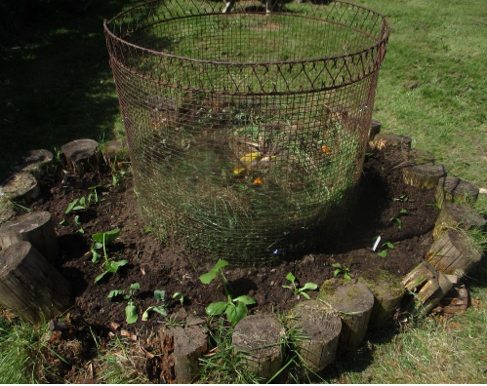

Slide 28
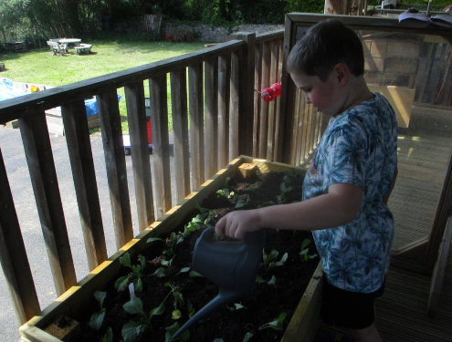

Slide 29
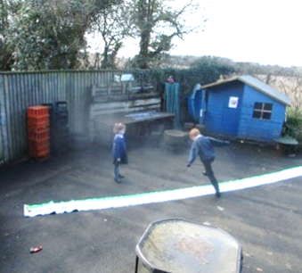
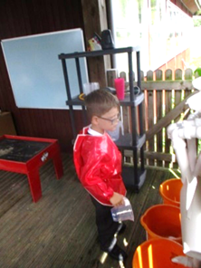

Slide 30
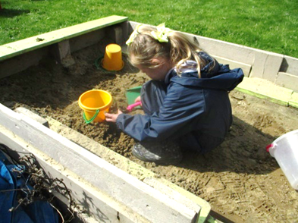
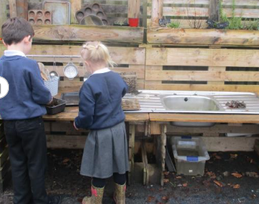

Slide 31
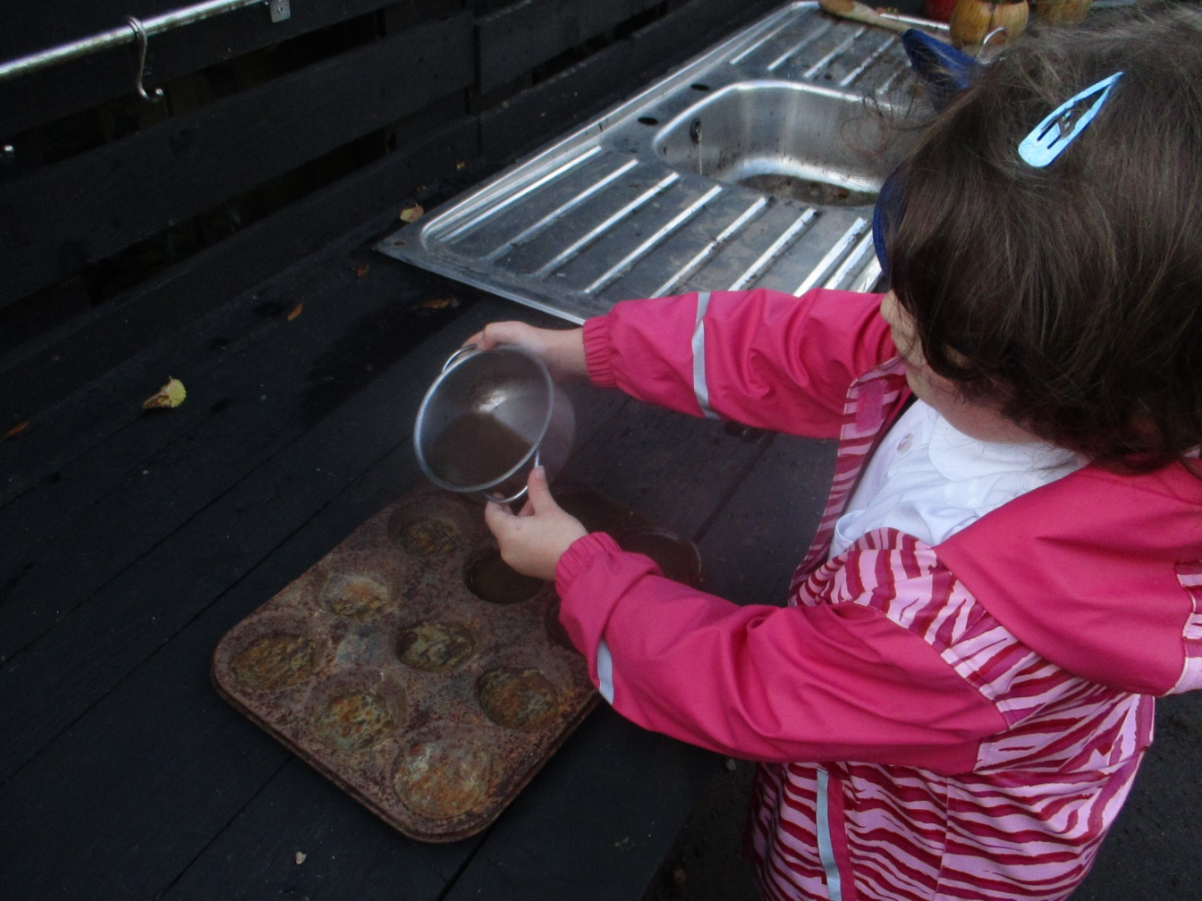
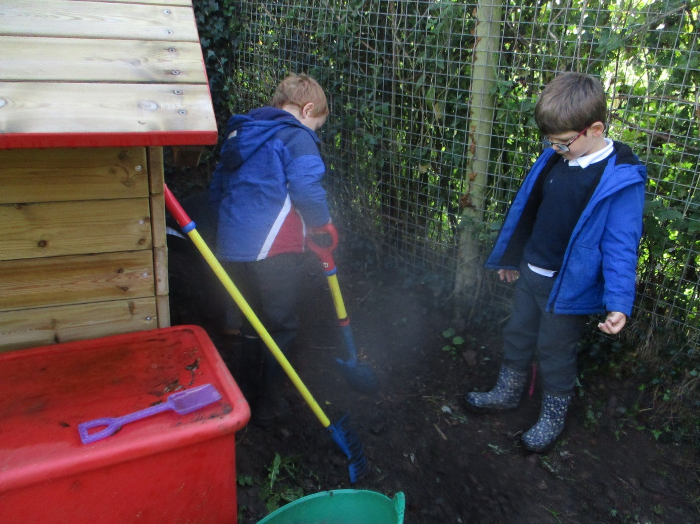

Slide 32
We have lots of exciting books in our Library and technology such as IPads, Learnpads and Google Chromebooks to support learning.

Slide 33
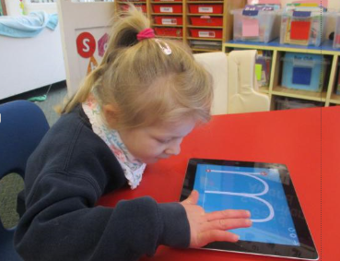
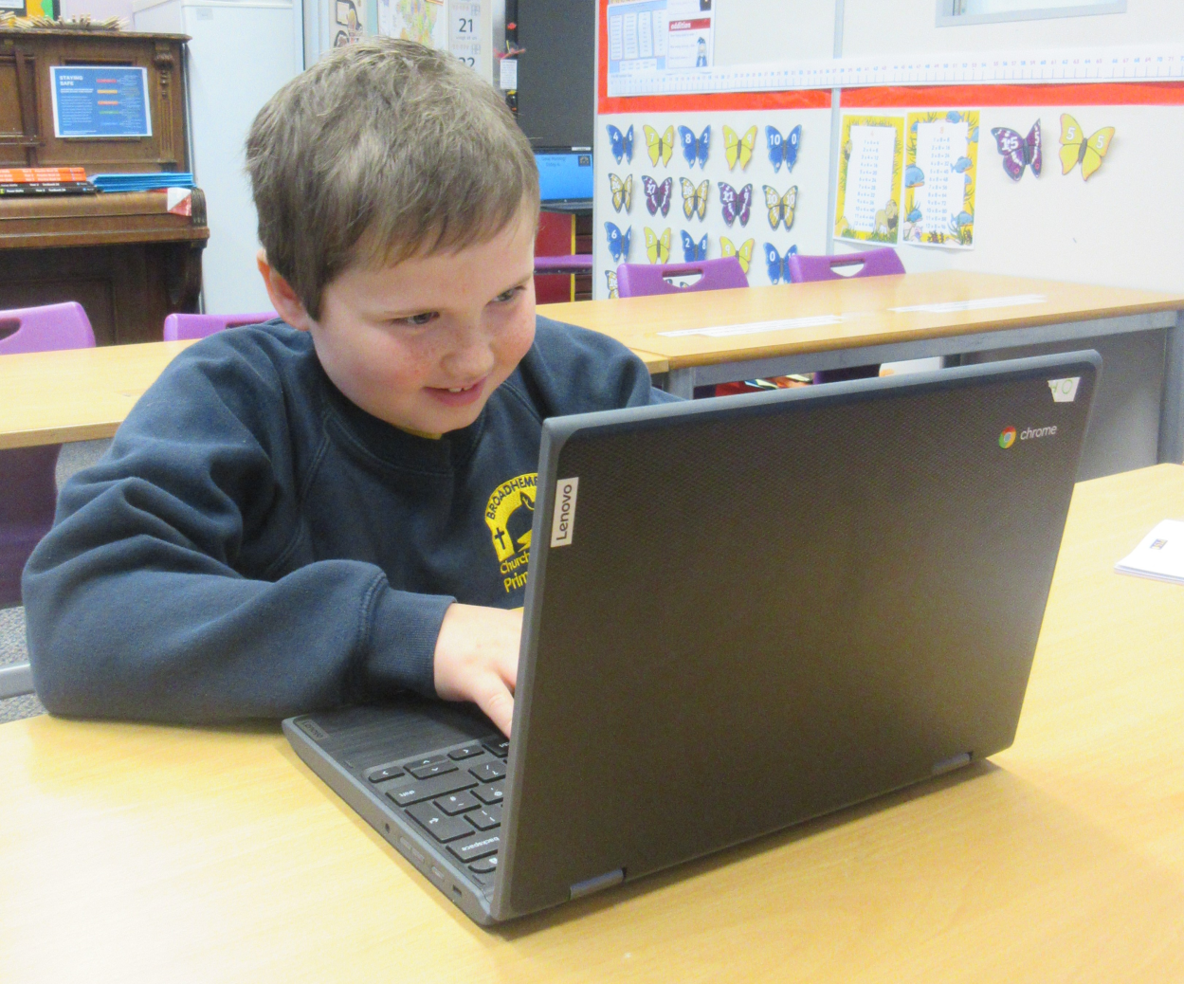

Slide 34
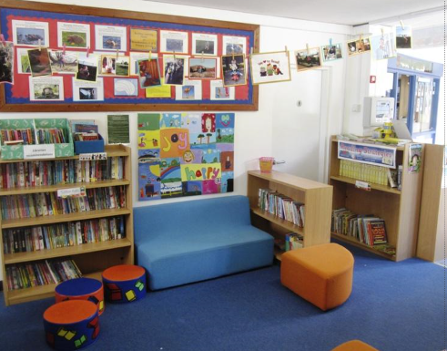
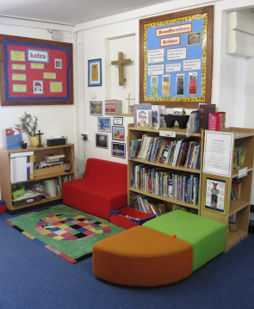

Slide 35
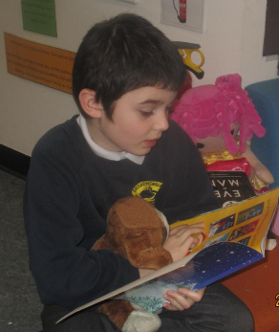

Slide 36
We love our learning and inspiring one another.

Slide 37
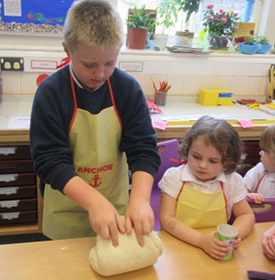
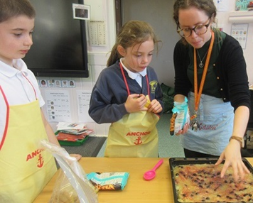

Slide 38
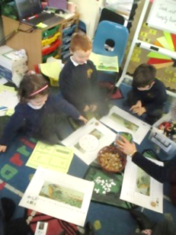
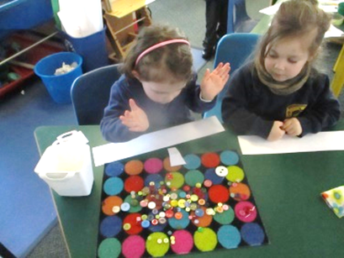

Slide 39
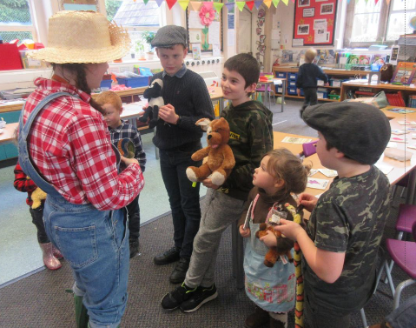

Slide 40
Class 2 enjoy working hard in their learning. The class teacher is Miss Watts.
They love working together but also enjoy becoming more independent learners too.
They have an exciting time developing their creativity and being good community citizens.

Slide 41
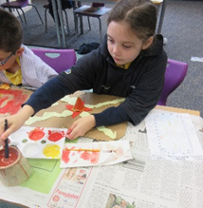
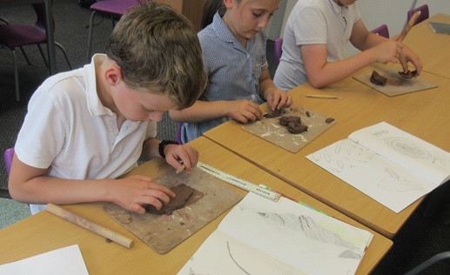

Slide 42
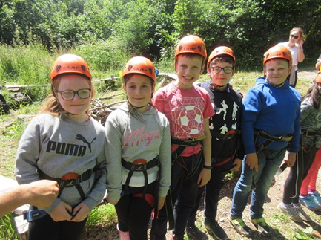

Slide 43
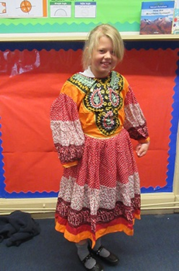

Slide 49
First Aid

Slide 50
We have Paediatric First Aiders and trained First Aiders on site at all times.
All injuries are recorded and accident notes sent home. If we have any concerns, we will phone you.
We are only able to administer prescribed medication.

Slide 51
We have very strong links with our community and local church St Andrew’s, just a very short walk away.

Slide 57
We really look forward to seeing you soon and welcoming you to our school community!

Slide 59
Be who God meant you to be and you will set the world on fire!

Slide 60
We hope you found this overview useful until
we are able to welcome you into school in person.
Please also browse the rest of our website for a wealth of information about our school and feel free to phone and speak to Miss Prince for a chat about the school and a school place.
01404 841304
​
Ready to apply for a school place?
Click here to go to Devon County Council's admissions’ pages.

