Slide 1
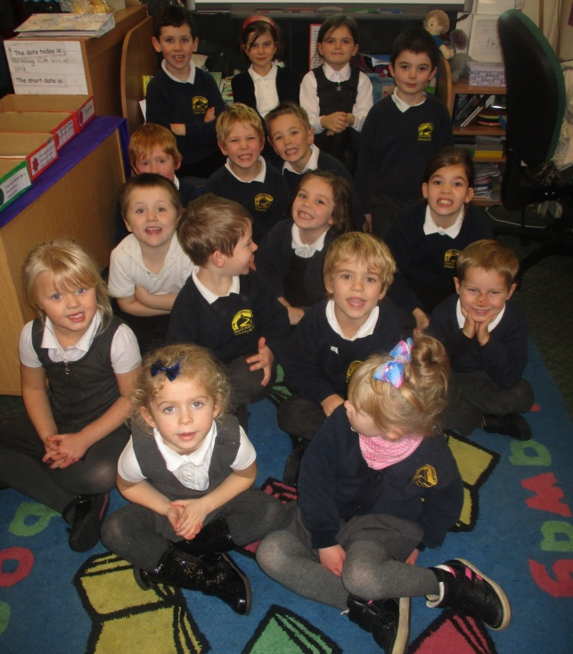
Class 1 presents Anti – Bullying Week 2017

Slide 2
Class 1 talked about what bullying meant to them.
They learnt about how unkind words and actions can hurt over a long period of time. The children decided that although saying sorry is a good thing, it does not repair all of the damage.

Slide 3
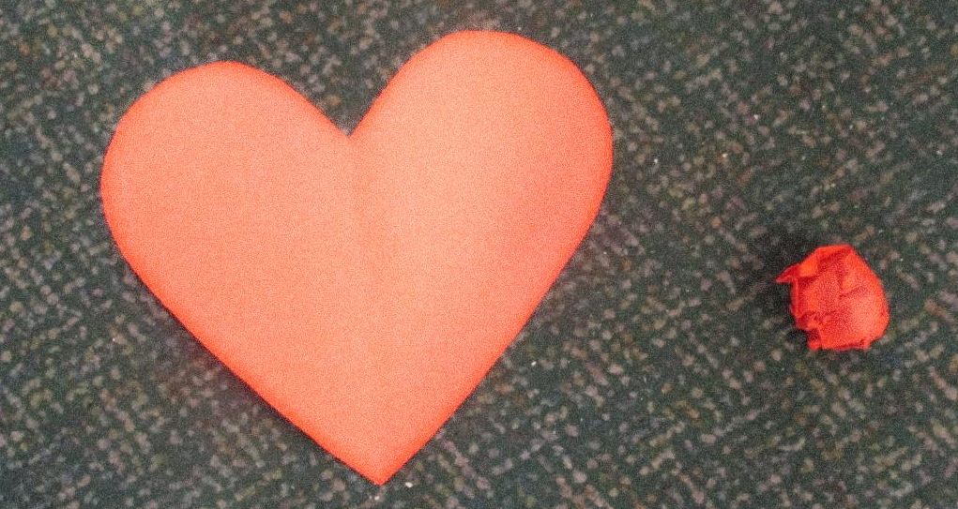
We did an activity which demonstrated this...
and no matter how many times we said sorry – our hearts still remained a little bit crinkled and lined.

Slide 4
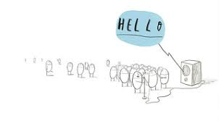
We reminded ourselves of a story that we know. It was all about about The Hueys – they were all the same but they were happy until one day...

Slide 5
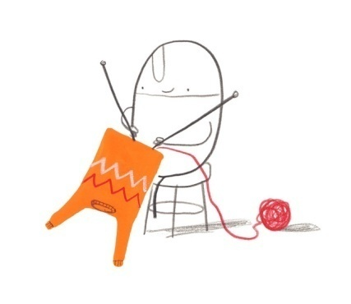
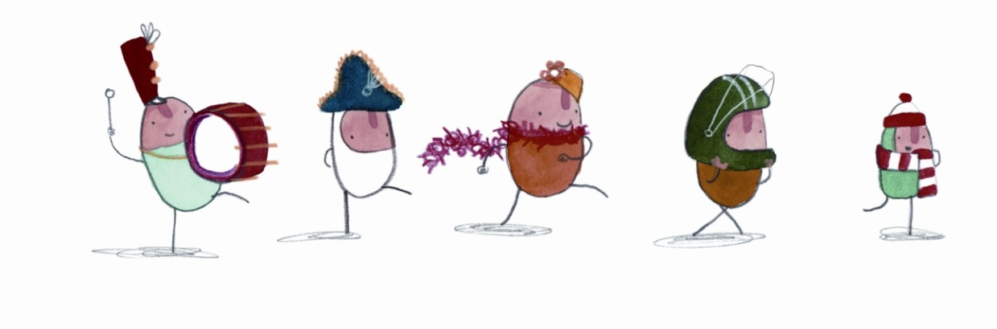
...one decided to be different by making himself a jumper.
This caught on...and then they were all the same again.
They each decided to wear a different hat so...
eventually they were all unique.

Slide 6
We are all unique and this is something that we should celebrate.
No one should be bullied for being unique.

Slide 7
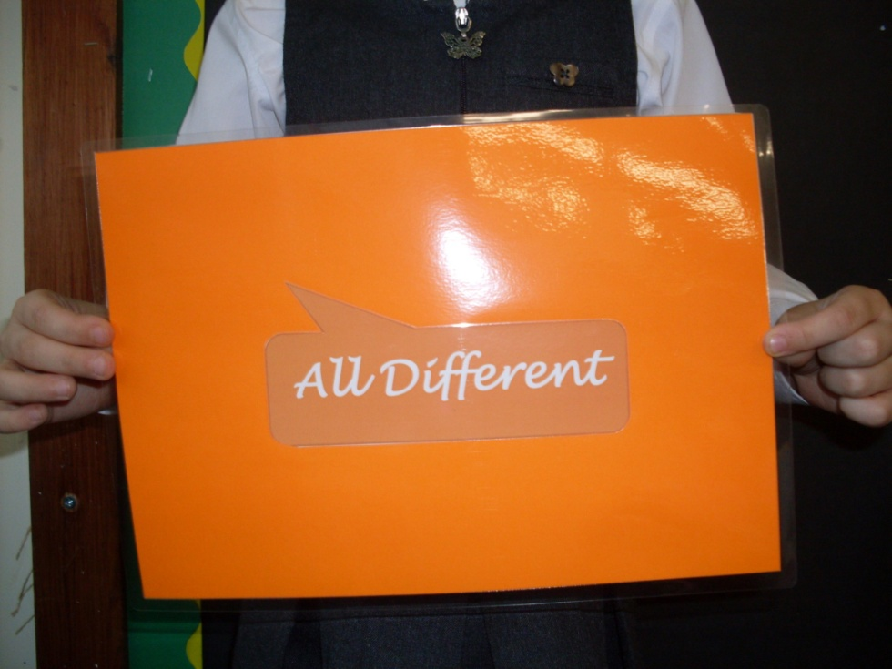
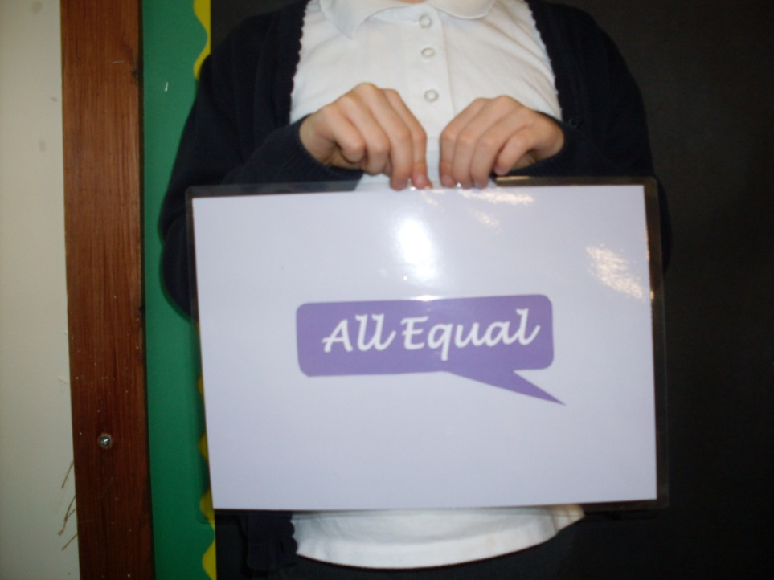
This year Anti-Bullying Week has the catchphrase ‘All Different, All Equal’.
Equal means equal in importance not just ‘the same as’ which is what we had learnt in
maths.

Slide 8
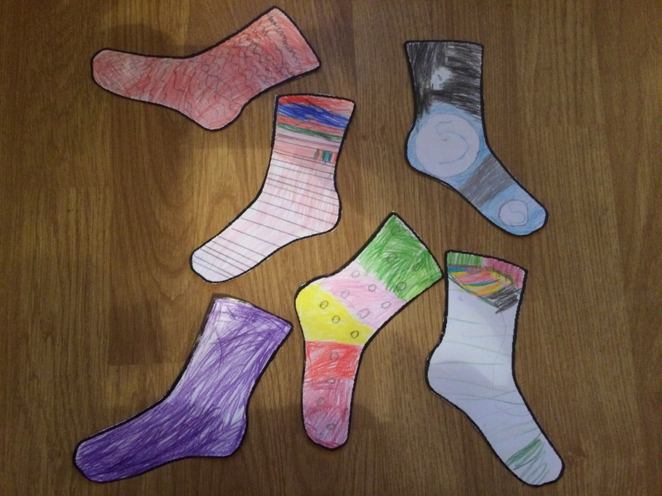
As part of Anti-bullying week, we were invited to wear odd socks to school on Monday.
This was meant to show that no one person is the same and was a way to celebrate our differences and show that we are all unique.

Slide 9
We designed our own odd socks!!

Slide 10
We talked about how we could remember what being bullied really meant.
This was what we found out...
It is a simple way to remember.

Slide 11
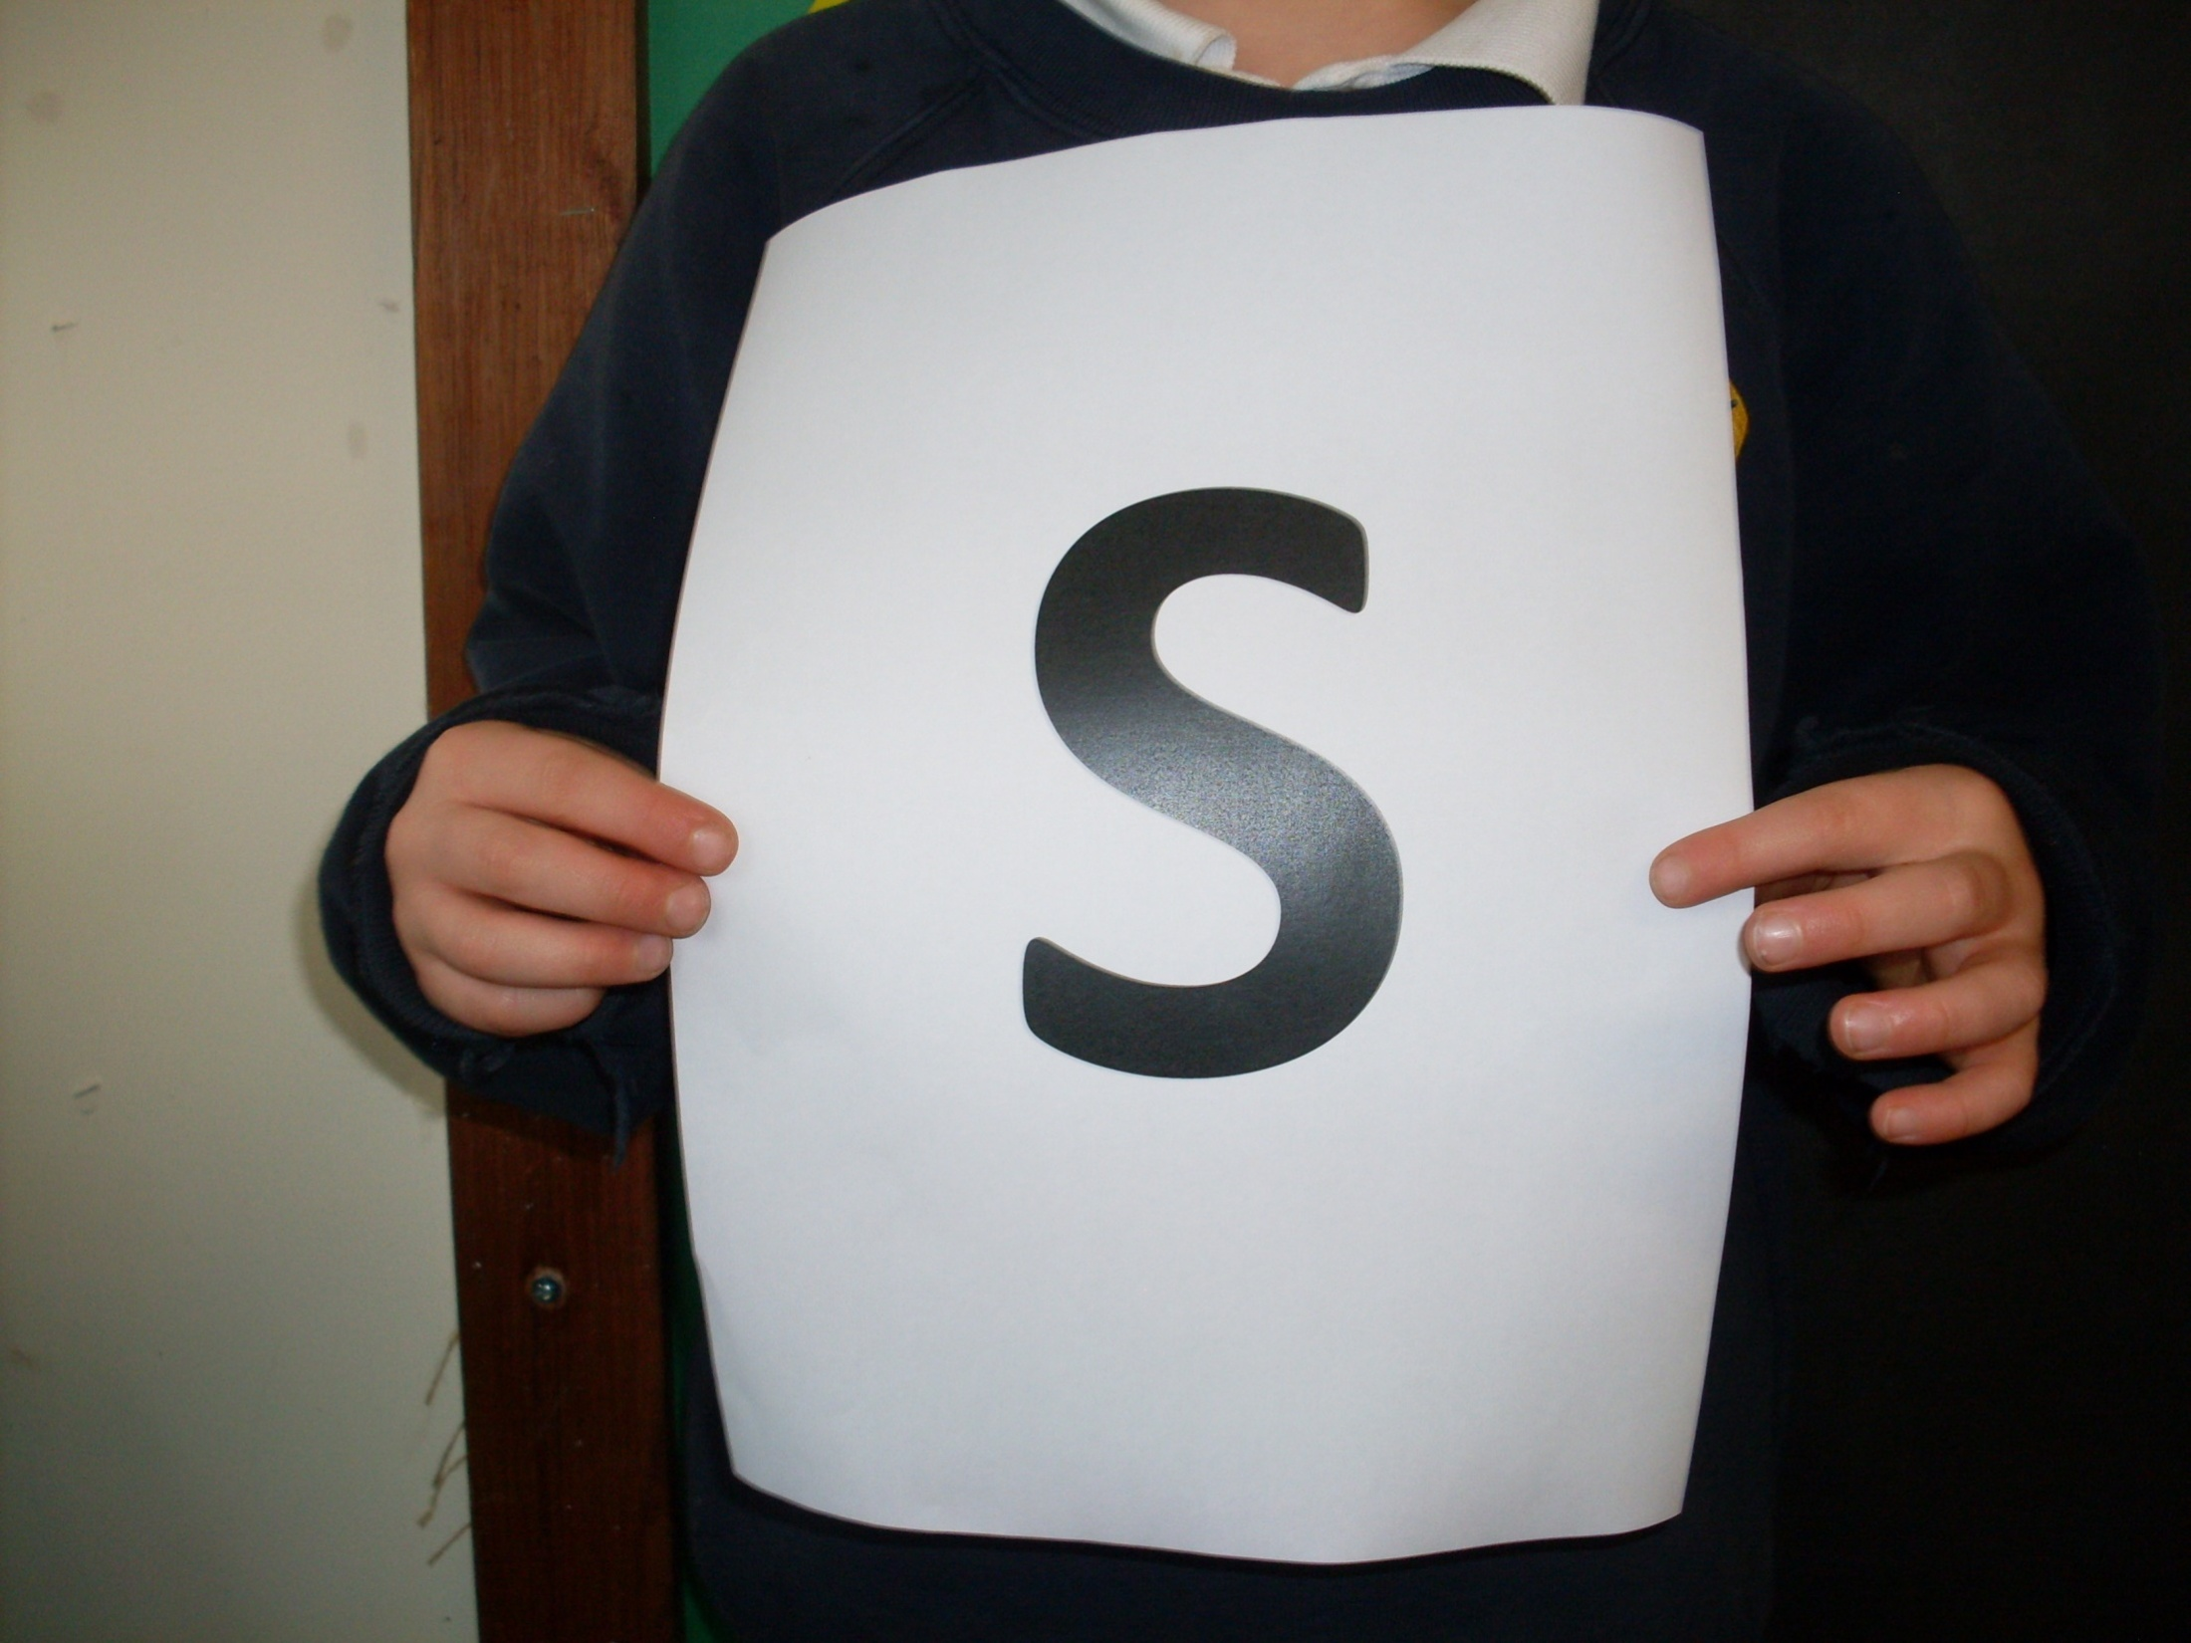

Slide 12
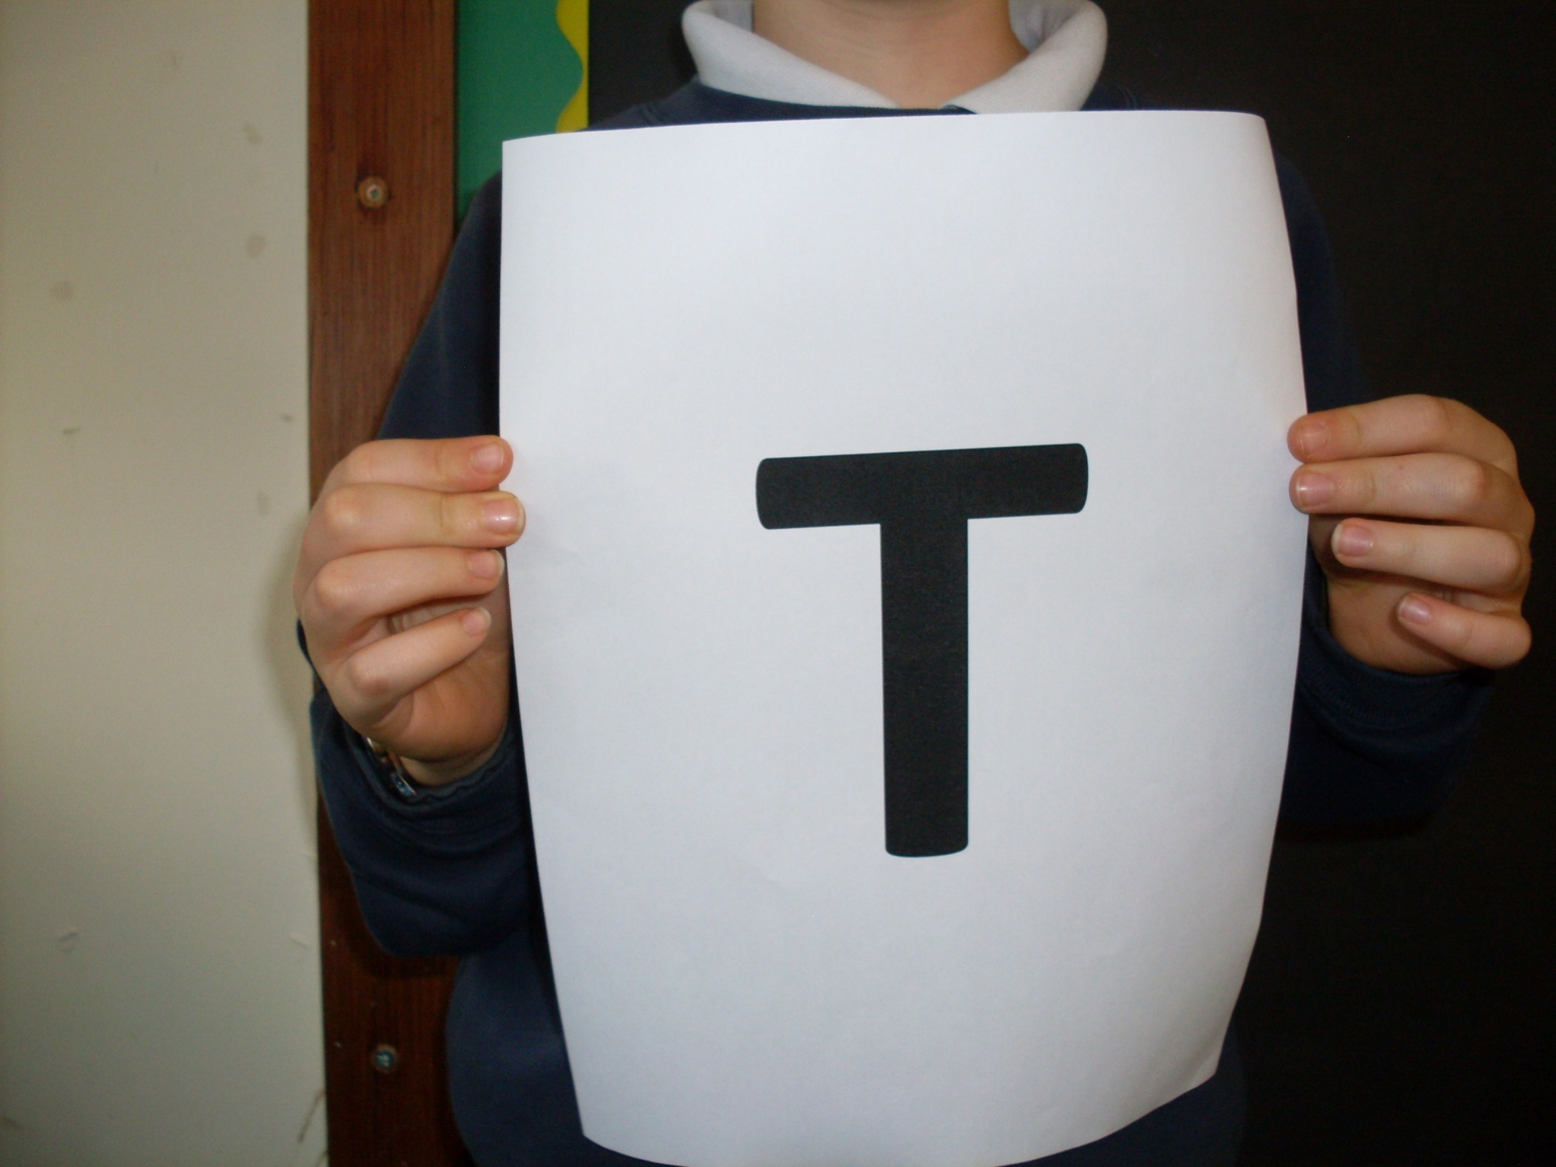

Slide 15
This is what the abbreviations stood for...

Slide 20
At Broadhembury, we work hard to make sure that bullying does not happen. We know that if we are worried, we can always speak to an adult at school, or someone else that we trust.
Together, we will all celebrate being unique and look after each other.

Slide 21
Thank you
for watching

